Slide 1
PSCS_278 – Smart Competency Diagnostic and Profile Score Calculator
PIP4004 Capstone Project
Final Review
Batch Number: CAI-G19
Roll Number | Student Name
20221CDV0002 | FAUZAN BIN JAVID
20221CDV0007 | TILAK HEJIB
20221CDV0044 | BHARAT KAUSHIK
Under the Supervision of
Dr. AKSHATHA Y
Assistant Professor
School of Computer Science and Engineering
Presidency University
Name of the Program: B.tech Computer Science and Technology (DevOps)
Name of the HoD: Dr. Pravinthraja S
Name of the Program Project Coordinator: D. H M Manjula
Name of the School Project Coordinators: Dr. Sampath A K , Dr. Geetha A

Slide 2
Content
Problem Statement
Github Link
Analysis of Problem Statement
Timeline of the Project
References

Slide 3
Problem Statement Number: PSCS48
Organization: Government of Punjab
Category (Hardware / Software / Both) : Software
Problem Description: Traditional employment platforms rely on manual or keyword-based matching, often failing to align candidate skills with job requirements accurately.
Lack of real-time skill assessment: Current systems rarely offer dynamic, real-time diagnostics to evaluate candidate competencies, leading to outdated or incomplete skill profiles.
Limited personalization in recommendations: Many platforms provide generic job or training suggestions, neglecting individual candidate profiles, career goals, or skill gaps.
Absence of continuous upskilling support: There is a gap in tools that periodically assess skills and recommend targeted upskilling to keep candidates competitive in evolving job markets.
Inadequate career path planning: Candidates often lack clear, visualized guidance on career trajectories, making long-term planning challenging.

Slide 4
Github Link
The Github link provided should have public access permission.
Github Link
https://github.com/FauzanJavid/Smart-Competency-Diagnostic-and-Profile-Score-Calculator

Slide 5
Analysis of Problem Statement
Domain: Educational Technology & AI-Powered Assessment
Languages: JavaScript, TypeScript
Frontend Libraries & Frameworks:
React 18.3.1 (UI framework)
TanStack Query (state management)
Monaco Editor (code editor)
Recharts (data visualization)
Tailwind CSS, Shadcn/UI (styling)
Backend & Infrastructure:
Supabase (BaaS platform)
Deno (serverless runtime)
PostgreSQL (database with RLS)
External APIs & Services:
Judge0 API (sandboxed code execution)
Lovable AI Gateway (LLM integration)
Large Language Models: Gemini, GPT
Database: PostgreSQL (via Supabase)
Interface: React SPA with Vite bundler

Slide 6
Analysis of Problem Statement (contd...)
Software Requirements:
Frontend: React 18.3.1, TypeScript, Vite, Tailwind CSS, Monaco Editor, TanStack Query
Backend: Supabase (PostgreSQL, Edge Functions, Authentication)
External APIs: Judge0 (Code Execution), Lovable AI Gateway (LLM)
Development Tools: Git, VS Code, Chrome DevTools
Libraries: Shadcn/UI, Recharts, Zod, Lucide React
Hardware Requirements:
Development Machine: Intel i5/i7 or AMD Ryzen 5/7, 8GB+ RAM (16GB recommended), 256GB+ SSD, Windows 10+/macOS 10.15+/Linux
Client Machine: Any modern device with web browser (Chrome/Firefox/Safari/Edge), 4GB+ RAM, stable internet connection
Cloud Infrastructure: Supabase Cloud (serverless), Judge0 API, CDN (Netlify/Vercel) - No dedicated servers required

Slide 7
Analysis of Problem Statement (contd...)
The employment landscape is evolving rapidly, with industries demanding candidates who possess not only qualifications but also relevant, verifiable skills. Current employment platforms and job portals, however, face several critical limitations:
Existing Challenges
Unreliable Skill Representation
Most platforms depend on resumes or self-declared skills.
No standardized diagnostic mechanism exists to evaluate a candidate’s true competencies.
Poor Candidate–Job Matching
Matching algorithms rely on keyword-based approaches, often producing irrelevant job recommendations.
Skill gaps are not identified, resulting in mismatched employment outcomes.
Limited Personalization
Generic recommendations are provided instead of adaptive, personalized learning paths.
Employers receive limited insights into a candidate’s readiness for a role.

Slide 8
Analysis of Problem Statement (contd...)
Proposed Integrated Solution
The proposed solution consolidates these advancements into a single platform, addressing the gap identified in traditional and ATS systems. It includes:
Accurate AI-Driven Diagnostics: Real-time quizzes and adaptive learning recommendations, supported by [2]’s resume analysis enhancements, provide dynamic skill profiling.
Fair, Bias-Free Matching: The matching engine, powered by Express.js/Node.js APIs, ensures equitable job assignments, aligning with [4]’s 20% efficiency gain.
Engaging Career Support: Interactive visualizations and upskilling suggestions, inspired by [3]’s career path models, enhance user engagement.

Slide 9
Analysis of Problem Statement (contd...)
Outcome:
Enhanced Technical Assessment: Students gain access to unified platform combining theoretical (MCQ) and practical (coding) evaluations with AI-driven personalized mentorship.
Improved Career Guidance: AI-powered recommendations provide tailored course suggestions and job role mapping based on individual competency profiles and skill gaps.
Scalable & Secure Evaluation: Serverless architecture with Row-Level Security ensures sub-2-second dashboard load times, sandboxed code execution, and data isolation for 100+ concurrent users.
Real-Time Performance Analytics: Interactive dashboards with competency visualization enable students to track progress across multiple domains and identify improvement areas.
Democratized Learning Resources: Cost-effective, cloud-based solution eliminates geographical and economic barriers to quality technical assessment and career planning tools.

Slide 10
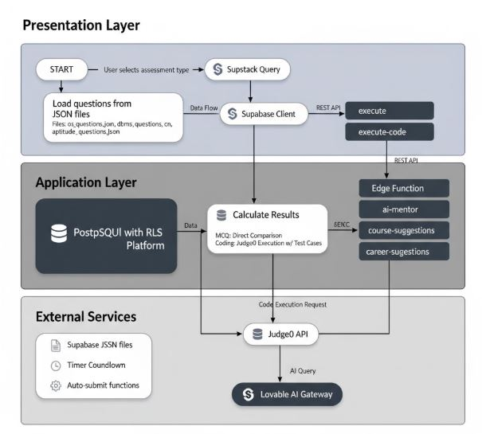
FLOWCHART

Slide 11
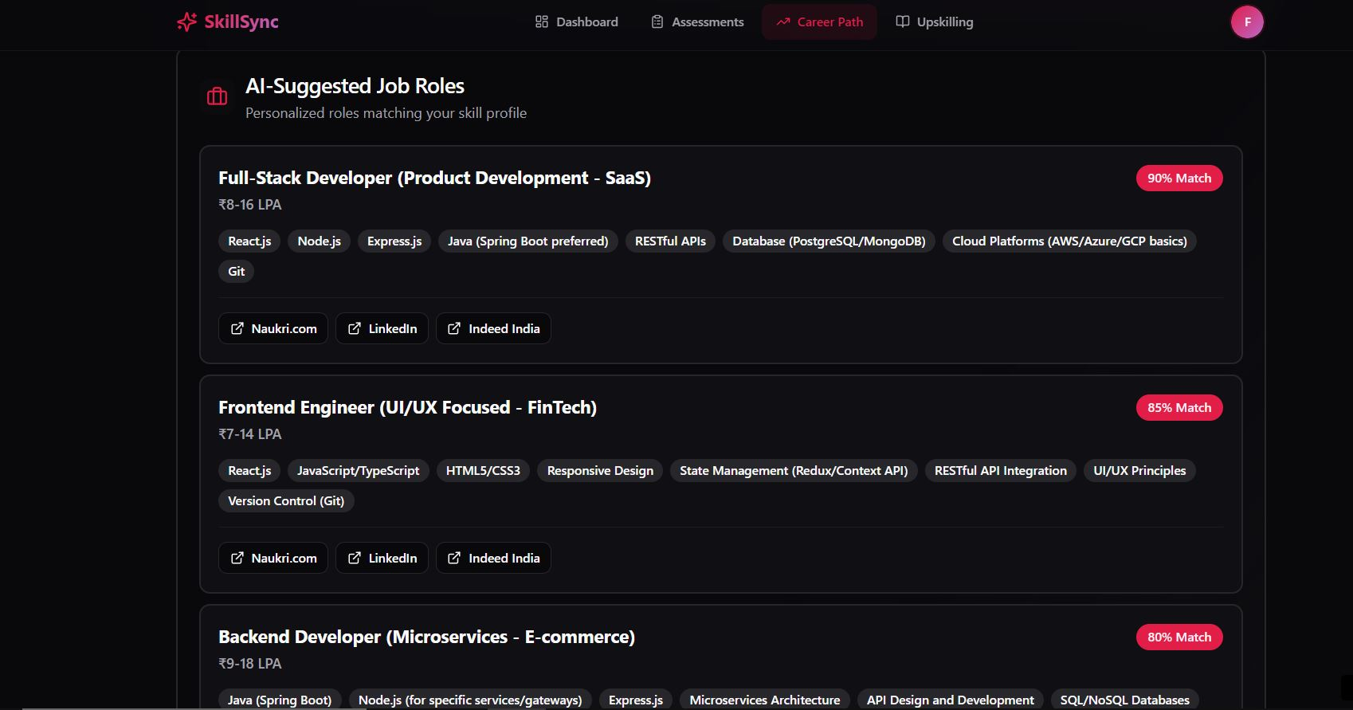
Results

Slide 12
Conclusion
The Smart Competency Diagnostic and Profile Score Calculator successfully integrates theoretical assessments, real-time code execution, and AI-driven mentorship into a unified serverless platform. Utilizing React 18.3.1, Supabase, Judge0 API, and LLM integration, the system achieved sub-2-second load times, 100% assessment accuracy, secure multi-language code execution, and <1-second AI response latency. Row-Level Security ensures data isolation while the serverless architecture supports 100+ concurrent users, demonstrating both technical excellence and scalability.The platform democratizes access to quality assessment and career guidance, aligning with SDGs 4, 8, and 9. Comprehensive testing validated all requirements, confirming readiness for deployment in academic and corporate environments. This project establishes a strong foundation for next-generation EdTech solutions, proving that AI-powered platforms can deliver professional-grade functionality while maintaining security, accessibility, and user-centric design.

Slide 13
References (IEEE Paper format)
[1] I. Khaouja, I. Kassou, and M. Ghogho, “A survey on skill identification from online job ads,” IEEE Access, vol. 9, pp. 118134–118153, 2021.
[2] A. Rajput, A. Dubey, and R. Thakur, “Career craft AI: A personalized resume analysis and job recommendations system,” in Proc. 1st Int. Conf. Innovative Sustainable Technol. Energy, Mechatronics, Smart Transp. (ISTEMS), Chennai, India, pp. 574–579, 2024.
[3] B. Ramadhani, P. H. Khotimah, P. P. Arhandi, and P. C. Siswipraptini, “Personalized career-path recommendation model for information technology students in Indonesia,” IEEE Access, vol. 12, pp. 49092–49105, 2024.
[4] S. Bhojne, P. Shah, S. Soares, P. Mulchandani, O. Patil, and K. P. Tambe, “Artificial intelligence enabled, social media leveraging job matching system for employers and applicants,” in Proc. 5th Biennial Int. Conf. Nascent Technol. Eng. (ICNTE), Mumbai, India, pp. 1–6, 2023.
[5] M. A. Ullah, M. Ahsan, M. T. Anjum, M. M. Ahmed, F. A. Silva, and A. H. M. Aman, “AI powered job recommendation system,” in Proc. 2024 Int. Conf. Inventive Computation Technol. (ICICT), Lalitpur, Nepal, pp. 1401–1406, 2024.
[6] K. R. Pushkar, S. Deepak, K. Arun, P. Kumar, P. Lal, and S. M. N. Islam, “A survey on artificial intelligence (AI) based job recommendation systems,” in Proc. 2023 14th Int. Conf. Computing Commun. Netw. Technol. (ICCCNT), Delhi, India, pp. 1–7, 2023.

Slide 14


